Slide 1
Beyond single species SDMs
Laura Pollock
CNRS (Center for National Scientific Research)
University of Grenoble Alps, France
McGill University, Montréal, Quebec

Slide 2
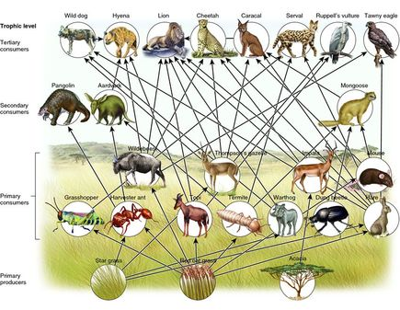
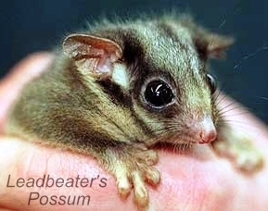
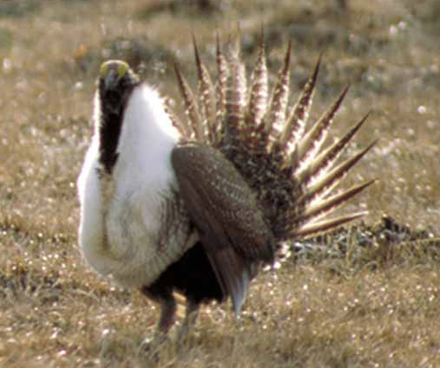
Ecosystems
Communities
Conservation Planning
Distribution Modelling
Single species

Slide 3
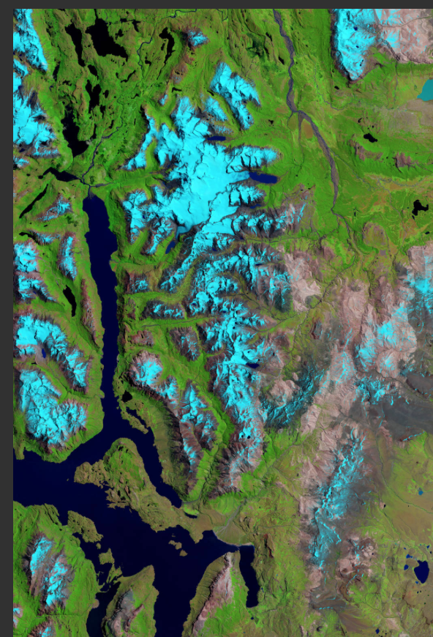

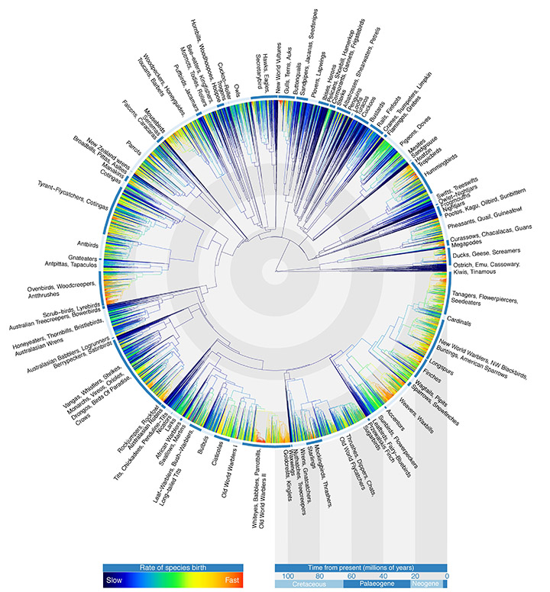
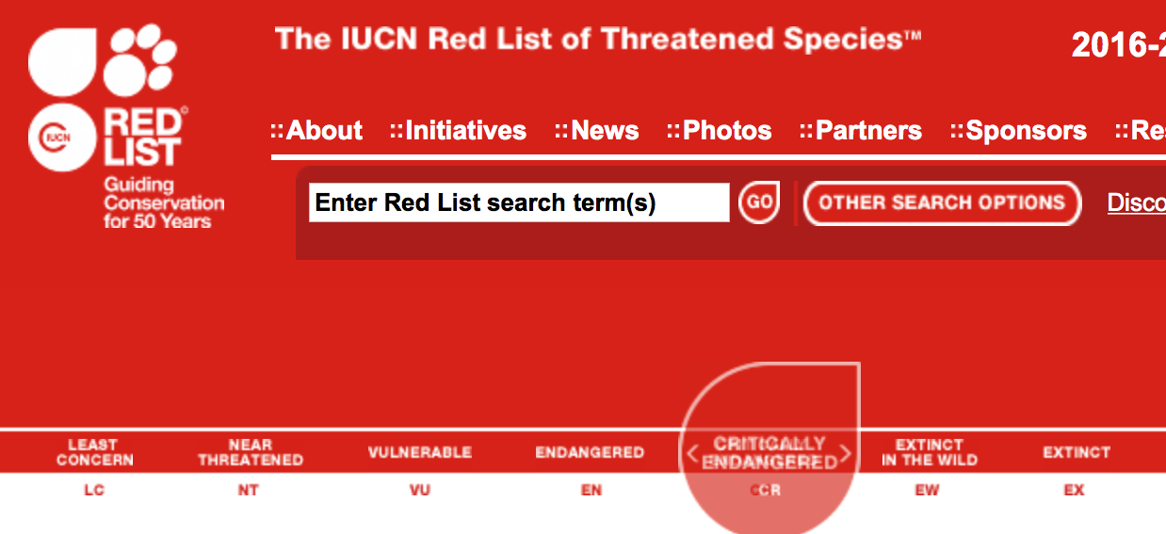
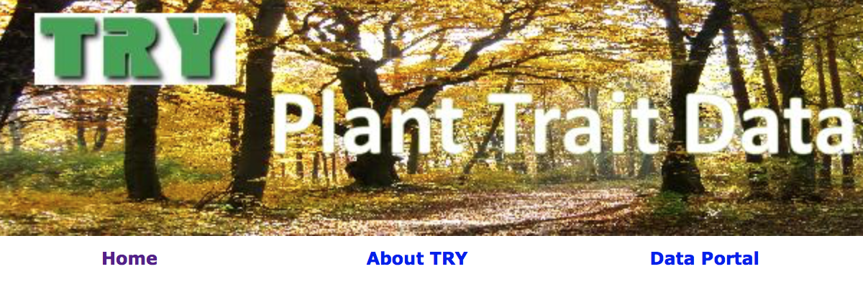
Biodiversity Data (species-level)

Slide 4
Depressing climate change graph here
Depressing biodiversity loss graph here

Slide 5
Why SDMs?
Not for species with great data..
Bulk of species with species-level attributes

Slide 6
Why multi-species models?
Biogeography/Macroecology
Community Ecology
‘biotic filter’
Functional Trait Ecology
Phylogenetic Community Ecology

Slide 7
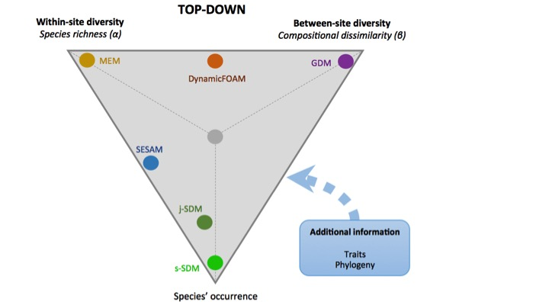

Slide 8
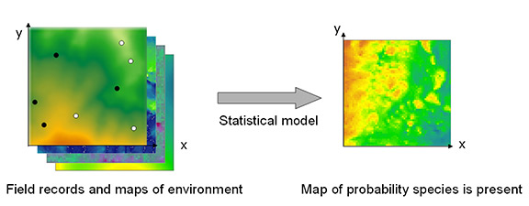
Species Distribution Model (SDM)
1
Prob. species occur.
0
Cold
Hot
Temperature
Notes:
Much of my work branches off species distribution modelling
SDMs (ENMs) are a very popular way to model biodiversity, usually the occurrnence of species
These models are advantageous for a number of reason..
-well known, realtively easy to model, lots of avaible data,.. They can be used for both ecological understanding as well as prediction
Used in applications from climate change research, invasion ecology, endangered species research
A species distribution model needs two things- location data for a species and some kind of attributes associated with those locations..

Slide 9
Why multi-species models over SDMs?
Species don’t occur in isolation
..biology/interpretation
Violates statistical assumptions –
Non-independence/residual correlation..
We can learn from other similar species..
.. And other species attributes - traits
..and other data linking species – phylogenies..

Slide 10
How to add species to an SDM?
Single species SDM
species occurrence ~ f ( Environment)
species occurrence ~ f ( Environment
+ pres/abund. other species)
+ presence other groups.. Richness..

Slide 11
Single species SDM
species occurrence ~ f ( Environment)
Multi-species SDM
Occurrence ~ f (Environment, species)

Slide 12
Multi-species model
Y_{ij} ~ Bernoulli (p_{ij} = 1)
G(p_{ij} = 1) ~ X_{i} B_{jk}
G = link function
Y = Binary occurrence data
X = enviro data
B = regression coefficients
k = enviro vars
i = sites
J = species

Slide 13
Multi-species model
Y_{ij} ~ Bernoulli (p_{ij} = 1)
G(p_{ij} = 1) ~ α_{j} + X_{i} B_{jk}
G = link function
Y = Binary occurrence data
X = enviro data
B = regression coefficients
k = enviro vars
i = sites
J = species
α_{j} ~ N (μ_{k ,} σ_{k})
B_{jk} ~ N (μ2_{k ,} σ2_{k})

Slide 14
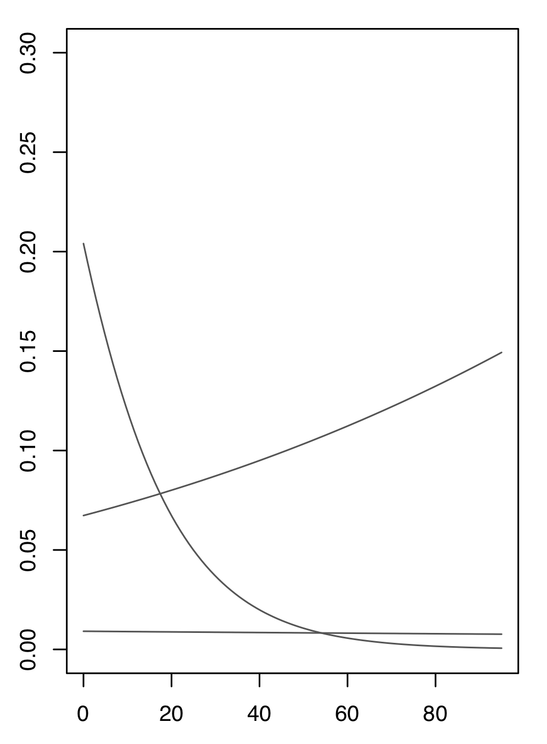
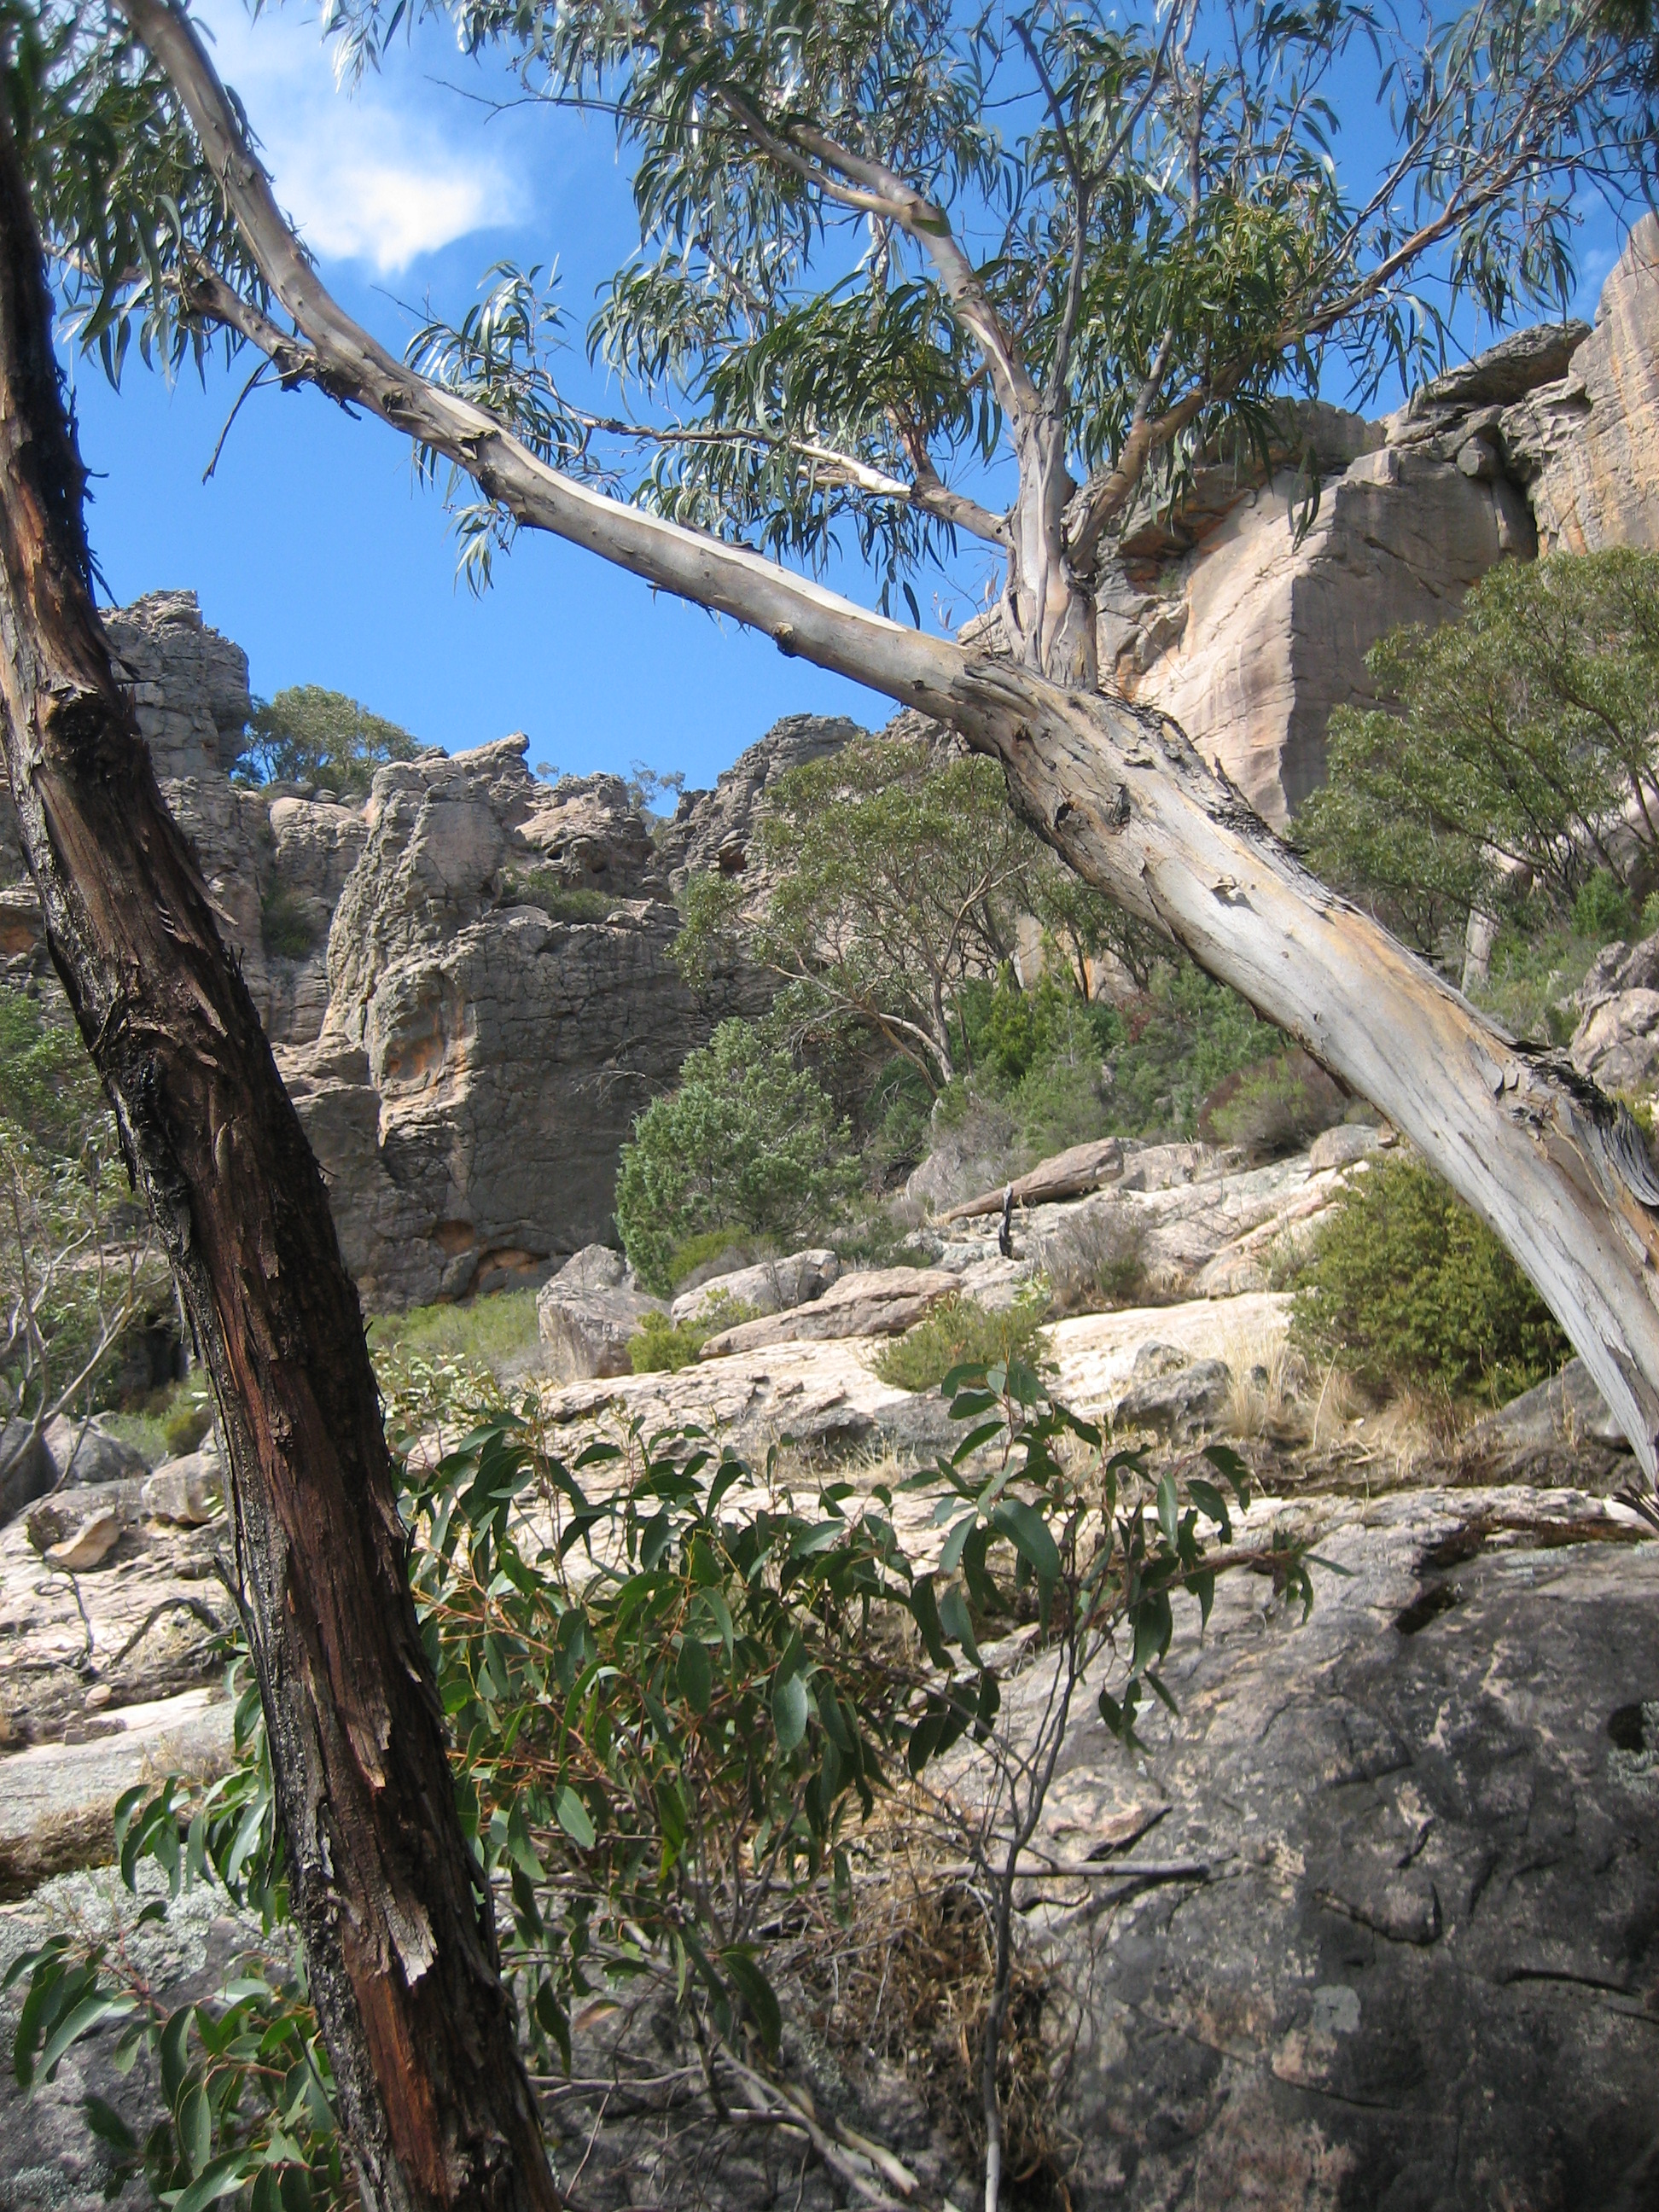
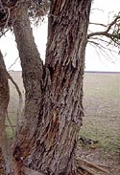
E. alaticaulis
Grampian Grey Gum
Prob. occurs
E. sabulosa
Western Scent Bark
Rockiness

Slide 15
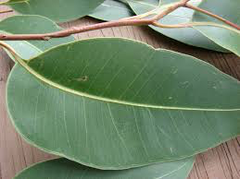
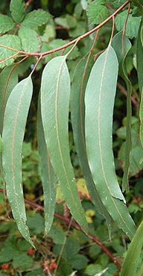
E. alaticaulis
Grampian Grey Gum
Prob. occurs
E. sabulosa
Western Scent Bark
Rockiness

Slide 16
Species occurrence = f (environment)
Level 1: Occurrence = f (environment, species)
Level 2: f (environment) = g (species | traits)

Slide 17
Multi-species model
Y_{ij} ~ Bernoulli (p_{ij} = 1)
G(p_{ij} = 1) ~ α_{j} + X_{i} B_{jk}
G = link function
Y = Binary occurrence data
X = enviro data
B = regression coefficients
k = enviro vars
i = sites
J = species
α_{j} ~ N (μ_{k ,} σ_{k})
B_{jk} ~ C_{k} + D_{kT} Trait_{j}

Slide 18
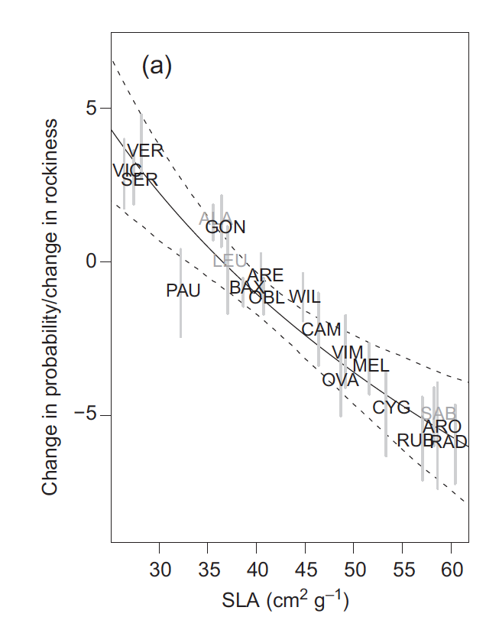

Slide 19
Multi-species model
Hierarchical Model
Species/traits act on regression params directly
What if there are correlations between species?

Slide 20
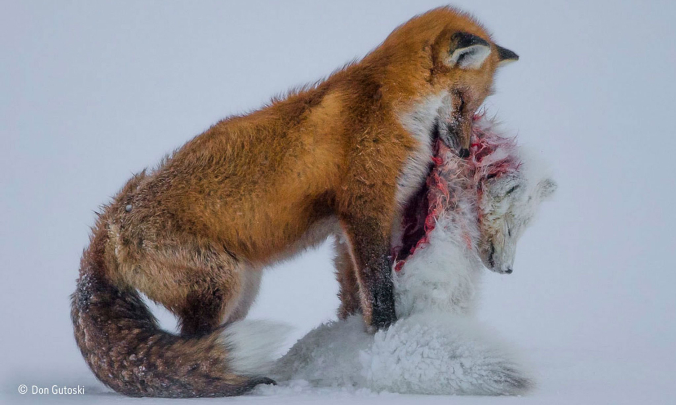
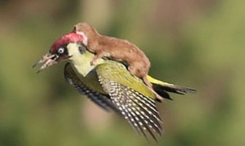
https://roaring.earth/fox-vs-fox/

Slide 21
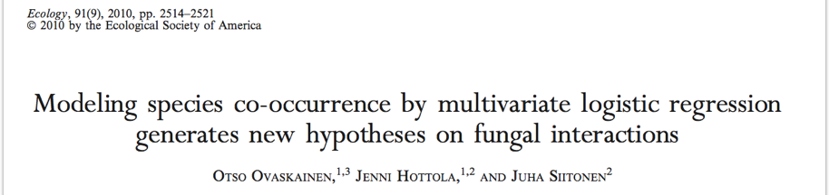

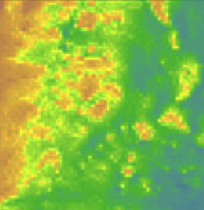
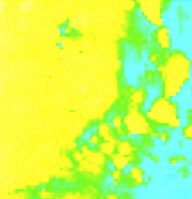

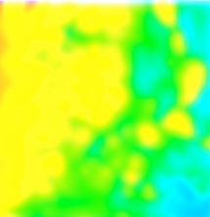


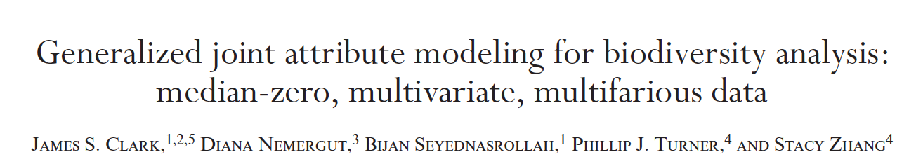
Joint Species Distribution Models (JSDMs)
’The Wild West of ecological statistics’ -Carsten Dormann

Slide 22
JSDM - latent variable probit regression
Y_{ij} ~ MV Bernoulli (p_{ij} = 1, P)
G(p_{ij} = 1) ~ X_{i} B_{jk}
P = correlation matrix
G = link function
Y = Binary occurrence data
X = enviro data
B = regression coefficients
k = enviro vars
i = sites
J = species

Slide 23

JSDM - latent variable probit regression
Pr (Y_{ij} = 1) = Pr (Z_{ij} > 0)
Z_{ij} ~ N (X_{i} B*, Σ)
B*_{jk} ~ N (μ_{k ,} σ_{k})
B* = unscaled regression coefs

Slide 24
Latent structures in models..
Generalized linear models (GLMs)
LINK function – links linear predictor with binary response.. E.g. logistic regression, probit regression
Parameterize probit model INDIRECTLY via a latent formulation – unobserved variable..
Similar – links continuous pred/binary response

Slide 25
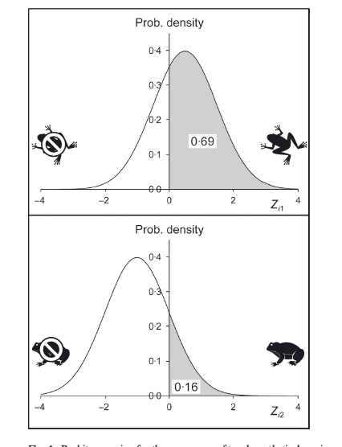

Slide 26
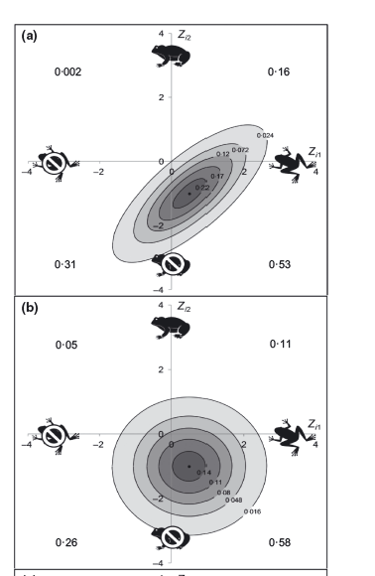

Slide 27
Hierarchical JSDM
Y_{ij} ~ MV Bernoulli (p_{ij} = 1, P)
G(p_{ij} = 1) ~ X_{i} B_{jk}
P = correlation matrix
G = link function
Y = Binary occurrence data
X = enviro data
B = regression coefficients
k = enviro vars
i = sites
J = species
α_{j} ~ N (μ_{k ,} σ_{k})
B_{jk} ~ N (μ2_{k ,} σ2_{k})

Slide 28
JSDM outputs
1. Correlation due to environment

Slide 29
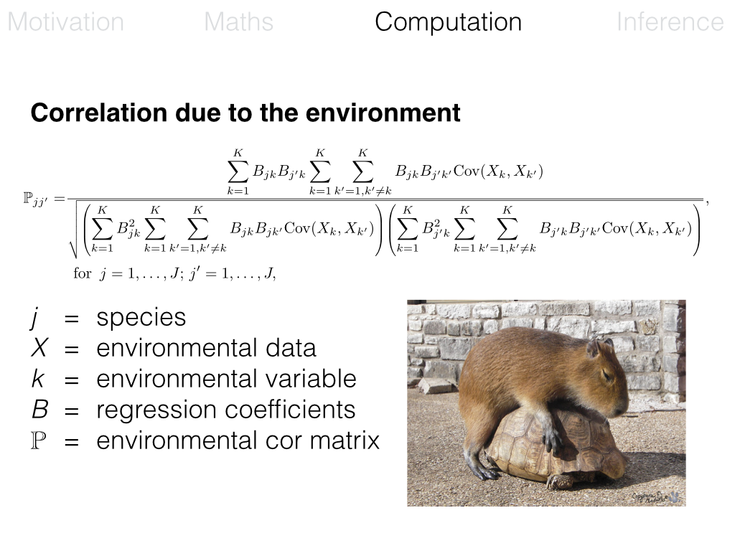

Slide 30
JSDM Outputs: Species Correlation
Environment
Prob. occurs
Grey Gum
Scent Bark
Rockiness

Slide 31
JSDM outputs
1. Correlation due to environment
2. Residual correlation

Slide 32
JSDM Outputs: Species Correlation
Environment
Residual
Bundy
Grey Gum
Grey Gum
Scent Bark
Scent Bark

Slide 33
Residual Correlation
Is it a problem or is it magic?

Slide 34
What do we know about species interactions?
Residual- hypotheses of interactions?

Slide 35
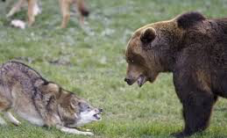
Facilitation
Competition
JSDM Residual Correlation
5 10 20
5 10 20
LJ Pollock and 8 co-authors. Catch me if you can: finding species interactions from occurrence data. In prep.

Slide 36
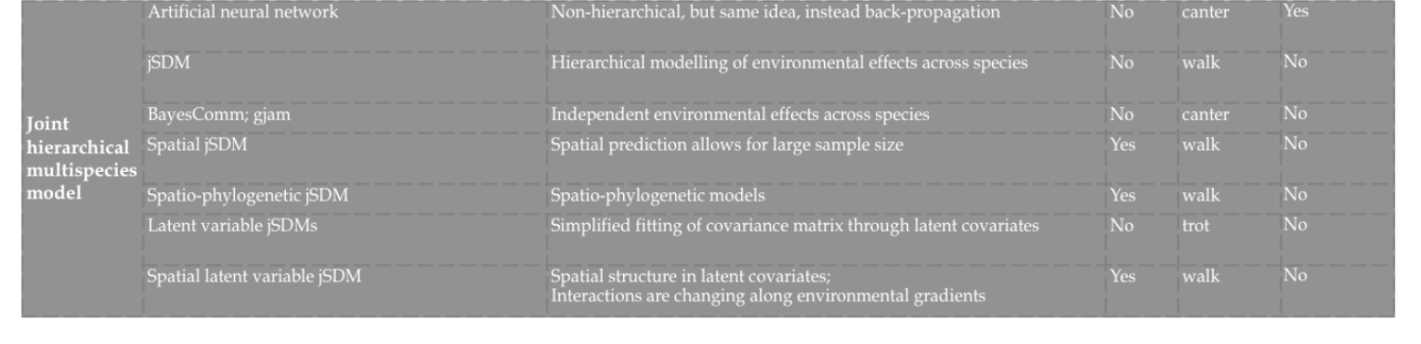
https://akcomputationalecology.wordpress.com/tag/species-distribution-models-sdm/

Slide 37
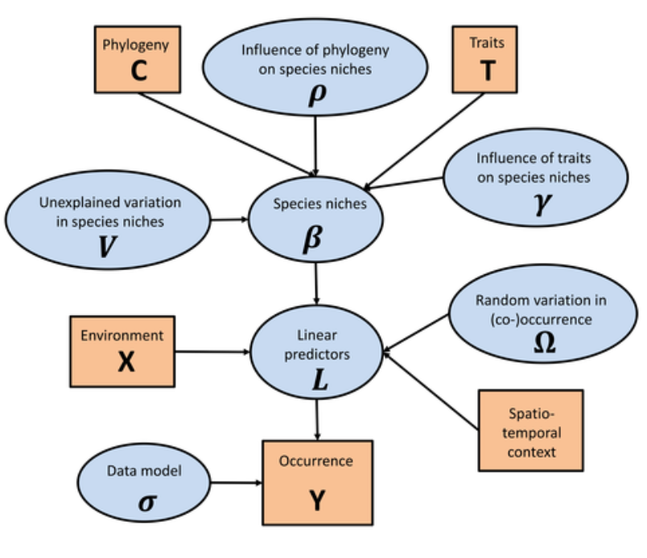
JSDM – advances HMSC - Ovaskainen

Slide 38
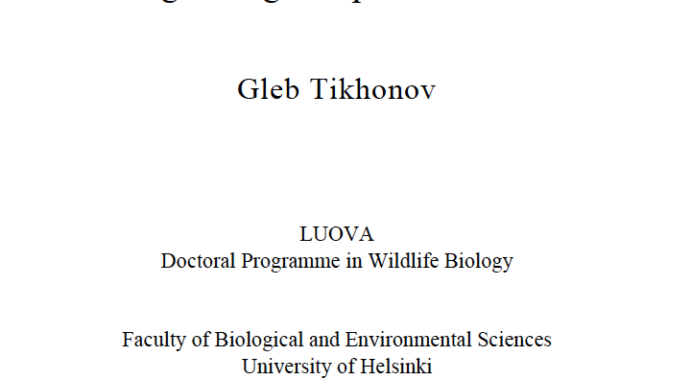
JSDM for many species

Slide 39
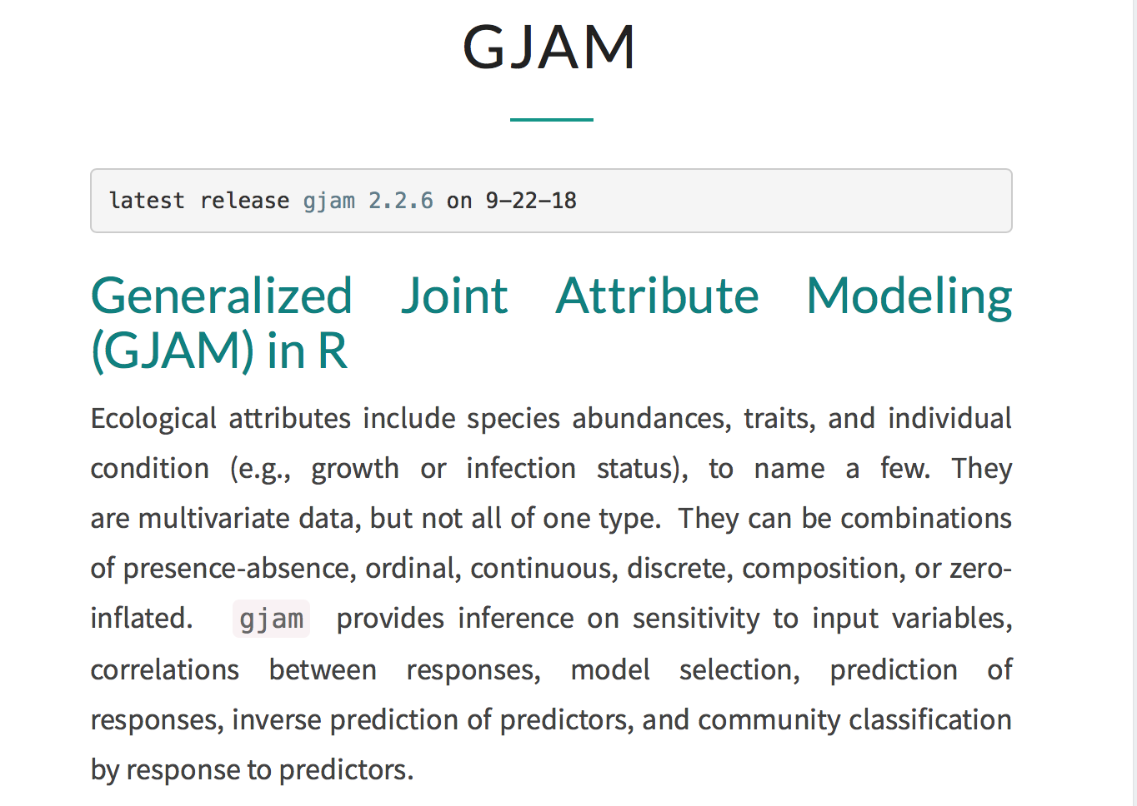
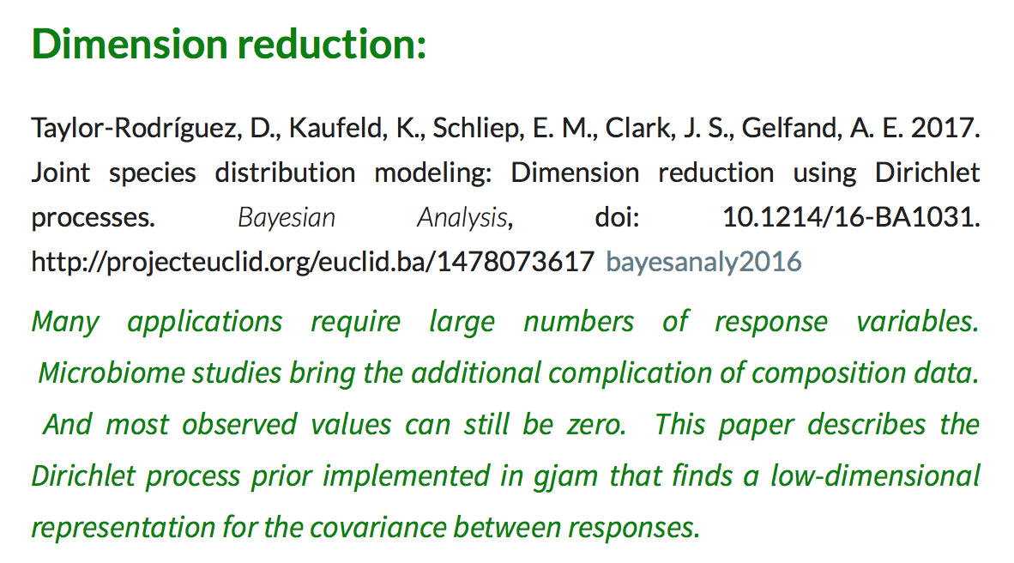
Advances - GJAM

Slide 40
Comparison to SDM

